Slide 1
MUNICIPAL SOLID WASTE MANAGEMENT 18CEO306T

Slide 2
TOPICS
Waste Disposal
Key Issues in Waste Disposal
Disposal Options and Selection Criteria
Landfill and its essential components
Types and methods of Landfill
Liner and its types
Materials used for liners
Daily cover and their objectives, materials used
Leachate Composition and properties
Leachate Formation-migration and control Leachate treatment
Landfill gas management system
Gas monitoring, treatment methods
Environmental Effects of Landfill
Landfill remediation and rehabitation of open dumps Integrated Waste Management (IWM)
Public Education and Involvement
Tutorial 7:Waste Disposal: A Case Study of Bangalore

Slide 3
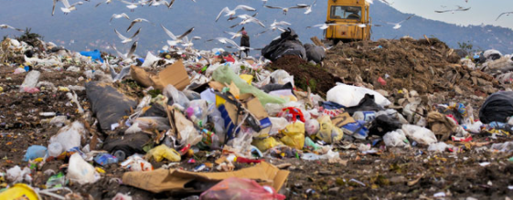
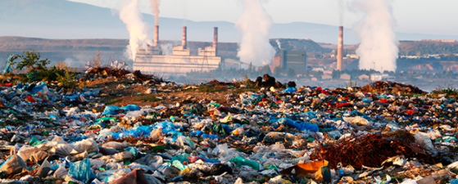
WASTE DISPOSAL
Municipal solid waste disposal is an intricate issue in most of the developing countries unlike in developed countries.
Poverty, population growth, and fast urbanization rates common to many developing countries are the major factors for concern.
In addition, the municipalities or the concerned authorities are not fully equipped to undertake the task of managing the wastes efficiently due to limited revenues/budget (UNEP 2002) through collection, transport, storage, treatment and disposal.
As a result, a substantial part of MSW generated remains unattended and pile up not only at the collection points but at street corners and public vacant places creating problem for public health and environment.

Slide 4
KEY ISSUES IN WASTE DISPOSAL
Disposal is the final element in the SWM system. It is the ultimate fate of all solid wastes, be they residential wastes collected and transported directly to a landfill site, semisolid waste (sludge) from municipal and industrial treatment plants, incinerator residue, compost or other substances from various solid waste processing plants that are of no further use to society.
It is, therefore, imperative to have a proper plan in place for safe disposal of solid wastes, which involves appropriate handling of residual matter after solid wastes have been processed and the recovery of conversion products/energy has been achieved.
It follows that an efficient SWM system must provide an environmentally sound disposal option for waste that cannot be reduced, recycled, composted, combusted, or processed further (Ali, et al 1999).
However, in these days, indiscriminate disposal of wastes in many regions is very common, giving rise to such problems as:

Slide 5
KEY ISSUES IN WASTE DISPOSAL
Health hazards (e.g., residents in the vicinity of wastes inhale dust and smoke when the wastes are burnt; workers and rag pickers come into direct contact with wastes, etc.);
pollution due to smoke;
pollution from waste leachate and gas;
blockage of open drains and sewers.
Clearly, safe disposal of solid wastes is important for safeguarding both public health and the environment

Slide 6
DISPOSAL OPTIONS AND SELECTION CRITERIA:
The most common disposal option practiced currently in many countries is either uncontrolled dumping or dumping with moderate control.
The environmental costs of uncontrolled dumping include breeding of disease causing vectors (e.g., flies, mosquitoes and rodents), pollution, odour and smoke.
However it, should be noted that the option selected for waste disposal must mesh with the existing socio-cultural milieu, infrastructure, etc.

Slide 7
DISPOSAL OPTIONS
Disposal options
In this Subsection, we will touch upon some the options available for waste disposal, and in that respect, we will consider the following:
Uncontrolled dumping or non-engineered disposal:
As mentioned, this is the most common method being practiced in many parts of the world, and India is no exception.
In this method, wastes are dumped at a designated site without any environmental control.
They tend to remain there for a long period of time, pose health risks and cause environmental degradation.
Due to the adverse health and environmental impact associated with it, the non-engineered disposal is not considered a viable and safe option

Slide 8
DISPOSAL OPTIONS
SANITARY LANDFILL:
Unlike the non-engineered disposal, sanitary landfill is a fully engineered disposal option in that the selected location or wasteland is carefully engineered in advance before it is pressed into service.
Operators of sanitary landfills can minimize the effects of leachate (i.e., polluted water which flows from a landfill) and gas production through proper site selection, preparation and management.
This particular option of waste disposal is suitable when the land is available at an affordable price, and adequate workforce and technical resources are available to operate and manage the site.

Slide 9
DISPOSAL OPTIONS
INCINERATION:
This refers to the controlled burning of wastes, at a high temperature (roughly 1200 – 1500C), which sterilizes and stabilizes the waste in addition to reducing its volume.
In the process, most of the combustible materials (i.e., self-sustaining combustible matter, which saves the energy needed to maintain the combustion) such as paper or plastics get converted into carbon dioxide and ash.
Incineration may be used as a disposal option, when land filling is not possible and the waste composition is highly combustible.
An appropriate technology, infrastructure and skilled workforce are required to operate and maintain the plant.
GASIFICATION:
This is the partial combustion of carbonaceous material (through combustion) at high temperature (roughly 1000C) forming a gas, comprising mainly carbon dioxide, carbon monoxide, nitrogen, hydrogen, water vapour and methane, which can be used as fuel.

Slide 10
DISPOSAL OPTIONS
PYROLYSIS:
This is the thermal degradation of carbonaceous material to gaseous, liquid and solid fraction in the absence of oxygen.
This occurs at a temperature between 200 and 900C. The product of Pyrolysis is a gas of relatively high calorific value of 20,000 joules per gram with oils, tars and solid burned residue (Ali, et al 1999).

Slide 11
SITE SELECTION PROCESS AND CONSIDERATIONS
SITE SELECTION PROCESS AND CONSIDERATIONS:
This requires the development of a working plan – a plan, or a series of plans, outlining the development and descriptions of site location, operation, engineering and site restoration.
Considerations for site include public opinion, traffic patterns and congestion, climate, zoning requirements, availability of cover material and liner as well, high trees or buffer in the site perimeter, historic buildings, and endangered species, wetlands, and site land environmental factors, speed limits, underpass limitations, load limits on roadways, bridge capacities, and proximity of major roadways, haul distance, hydrology and detours.

Slide 12
SITE SELECTION PROCESS AND CONSIDERATIONS
SITE SELECTION PROCESS AND CONSIDERATIONS:
Technical:
Institutional:
Financial:
Social:
Environmental:

Slide 13
LANDFILL PROCESS
LANDFILL PROCESSES:
The feasibility of land disposal of solid wastes depends on factors such as the type, quantity and characteristics of wastes, the prevailing laws and regulations, and soil and site characteristics. Let us now explain some of these processes.
SETTLING PROCESS:
The waste body of a landfill undergoes different stages of settling or deformation. Figure below illustrates these stages:

Slide 14
LANDFILL PROCESS
PRIMARY CONSOLIDATION:
During this stage, a substantial amount of settling occurs.
This settlement is caused by the weight of the waste layers.
The movement of trucks, bulldozers or mechanical compactors will also enhance this process.
After this primary consolidation, or short-term deformation stage, aerobic degradation processes occur.
SECONDARY COMPRESSION:
During this stage, the rate of settling is much lower than that in the primary consolidation stage, as the settling occurs through compression, which cannot be enhanced.

Slide 15
LANDFILL PROCESS
DECOMPOSITION:
During the degradation processes, organic material is converted into gas and leachate.
The settling rate during this stage increases compared to the secondary compression stage, and continues until all decomposable organic matter is degraded.
The settling rate, however, gradually decreases with the passage of time.

Slide 16
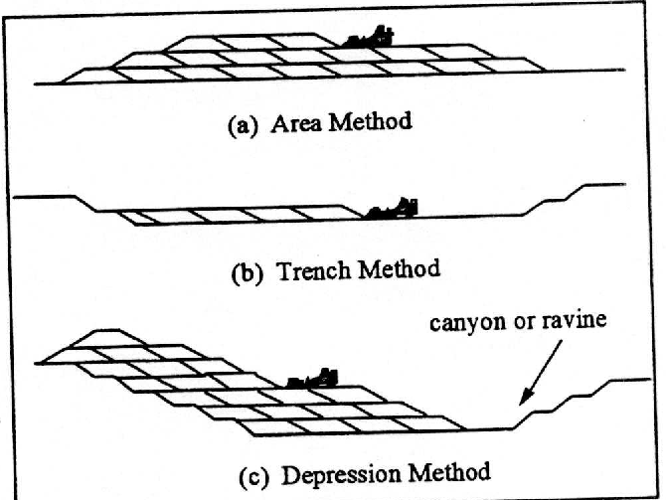
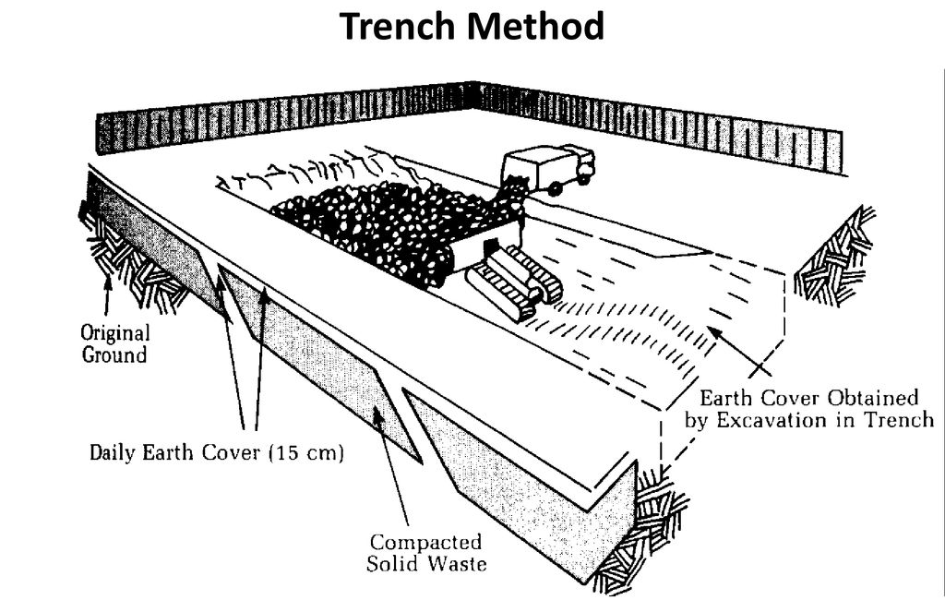
METHODS OF LANDFILLING

Slide 17
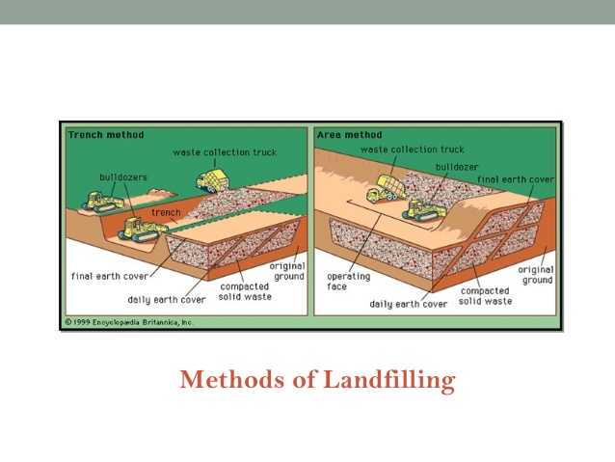
METHODS OF LANDFILLING
Excavated / Trench Method:
Ideally suited to areas where an adequate depth of cover material is available at the site and water table is not clear the surface.
Soil excavated from the site is used for daily and final cover.
Excavated cells are lined with synthetic membrane liners/ low permeability clay/combination of two to limit the movement of landfill gas and leachate.

Slide 18
METHODS OF LANDFILLING
Area Method:
Used when terrain is unsuitable for excavation of cells / trenches and Ground water table is high.
Site preparation includes installation of liners and leachate management system.
Cover material must be obtained from adjacent land/burrow, pit areas.

Slide 19
METHODS OF LANDFILLING
Area Method:
Since there is limited material for covering, compost, foundary sand has been utilized as intermediate cover material.
Temporary cover material of soil and geosynthetic blankets placed temporarily over completed cell and removed before lift is began.
Leachate generation may occur and may be difficult to control.

Slide 20
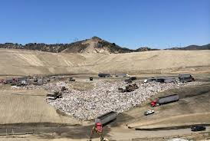
METHODS OF LANDFILLING
Canyon / Depression method:
This method refers to the placing of suitable wastes against lined canyon or ravine slide slopes.
Technique involves placement and compaction of SW in canyon depression
It differs with geometry of site, characteristics of available cover material, hydrology, geology of the site.
Control of the surface drainage is often a critical factor in this method.
Filling starts at the headed of canyon and ends at mouth to prevent accumulation of water behind the landfill.
Slope stability and leachate gas emission are critical issues for this type of waster placement.

Slide 21
ADVANTAGES OF LANDFILLING
In addition to provide an option for waste management, it also serves to improve/ reclaim poor quality land.
It raises the ground elevation/ surface grade of the site. Completed landfills have been converted to municipal parks, playgrounds, golf courses, community land use projects.
It is the most economical alternative for Solid waste disposal which accounts for its frequent application.

Slide 22
ADVANTAGES OF LANDFILLING
Other disposal methods are not entirely safe and efficient throughout the year.
Incineration is costly process, residue requires ultimate disposal on land.
Composting is a seasonal option.
It is not possible to reclaim and recycle all solid waste material
Thus landfilling is the most convenient option

Slide 23
DISADVANTAGES OF LANDFILLING
Difficult to find suitable site within economically feasible distance.
It is not possible to build a completely safe and secure solid waste landfill. Some of the pollutants may escape in the environment in the form of leachate.
Potential harm to public health due to air, soil, water and noise
Damage to local ecosystem
Public oppose.

Slide 24
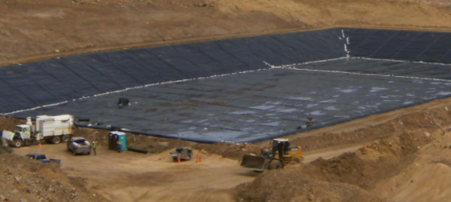
LINER AND ITS TYPES
Landfill liners are designed and constructed to create a barrier between the waste and the environment and to drain the leachate to collection and treatment facilities. This is done to prevent the uncontrolled release of leachate into the environment.
Society produces many different solid wastes that pose different threats to the environment and to community health. Different disposal sites are available for these different types of waste. The potential threat posed by the waste determines the type of liner system required for each type of landfill. Liners may be described as single (also referred to as simple), composite, or double liners.

Slide 25
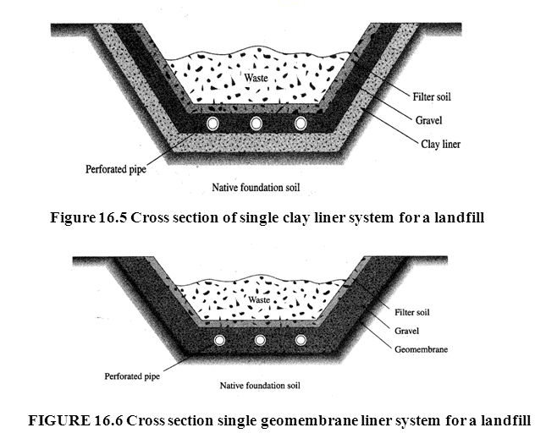
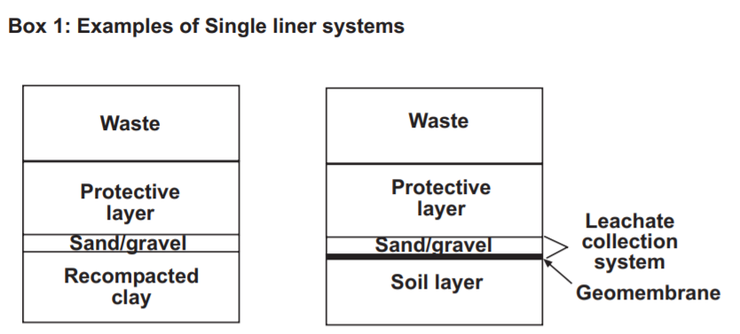
SINGLE-LINER SYSTEMS
Single liners (Box 1) consist of a clay liner, a geosynthetic clay liner, or a geomembrane (specialized plastic sheeting).
Single liners are sometimes used in landfills designed to hold construction and demolition debris (C&DD). Construction and demolition debris results from building and demolition activities and includes concrete, asphalt, shingles, wood, bricks, and glass.

Slide 26
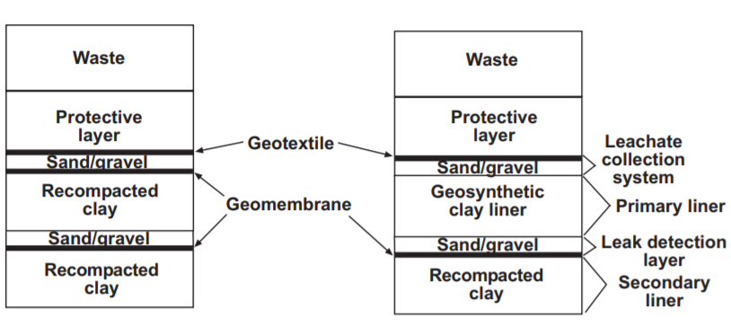
DOUBLE-LINER SYSTEMS
A double liner consists of either two single liners, two composite liners, or a single and a composite liner . The upper (primary) liner usually functions to collect the leachate, while the lower (secondary) liner acts as a leak-detection system and backup to the primary liner.
Double-liner systems are used in some municipal solid waste landfills and in all hazardous waste landfills.
Hazardous waste landfills (also referred to as secure landfills) are constructed for the disposal of wastes that once were ignitable, corrosive, reactive, toxic.

Slide 27
METHOD OF TREATMENT FOR VARIOUS TYPES OF SOLID WASTE
Methods of Solid Waste Disposal and Management:
1) Solid Waste Open Burning 2) Sea dumping process 3) Solid wastes sanitary landfills 4) Incineration method 5) Composting process 6) Disposal by Ploughing into the fields 7) Disposal by hog feeding 8) Salvaging procedure 9) Fermentation/biological digestion

Slide 28
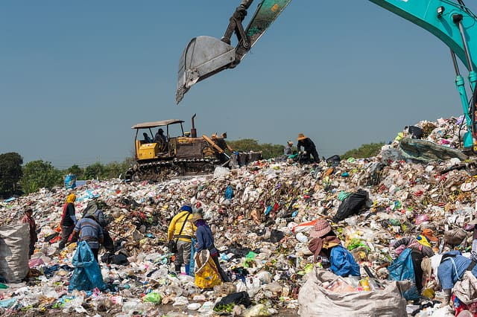
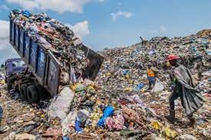
OPEN DUMPS
Open dumps refer to uncovered areas that are used to dump solid waste of all kinds.
The waste is untreated, and not segregated.
It is the breeding ground for files, rats, and other insects that spread disease.
The rainwater run-off from these dumps contaminates nearby land and water, thereby spreading disease. In some countries, open dumps are being phased out.

Slide 29
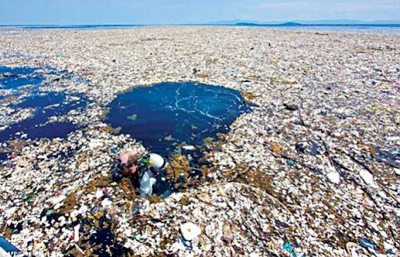
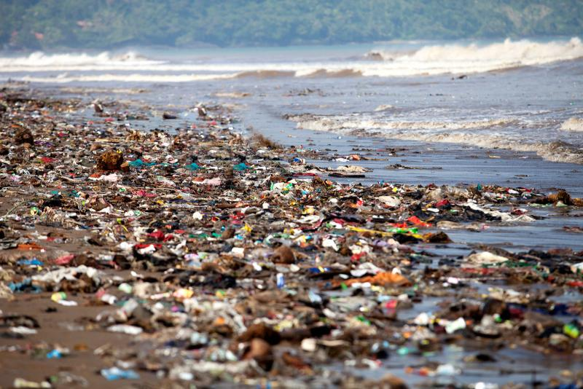
SEA DUMPING PROCESS
SEA DUMPING PROCESS:
This sea dumping process can be carried out only in coastal cities. This is very costly procedure and not environment friendly.
It consists of dumping materials from land or from a vessel, or discharging them through a pipe into marine waters. Ocean waste disposal is purposeful as opposed to accidental. The discharge is directly to marine waters as opposed to indirectly through rivers or groundwater.

Slide 30
LANDFILLS
A landfill may also refer to the ground that has been filled in with soil and rocks instead of waste materials, so that it can be used for a specific purpose, such as for building houses.
Landfill, also known as a dump or tip, is a site for disposal of waste materials by burial. Older, poorly designed or poorly managed landfills can create a number of adverse environmental impacts such as wind-blown litter, attraction of vermin, and generation of liquid leachate.

Slide 31
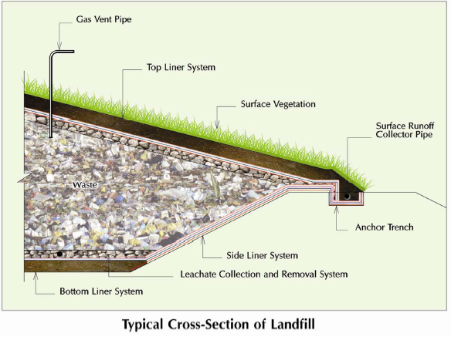
LANDFILL
A municipal solid waste landfill (MSWLF) is a discrete area of land or excavation that receives household waste.
A MSWLF may also receive other types of nonhazardous wastes, such as commercial solid waste, nonhazardous sludge, conditionally exempt small quantity generator waste, and industrial nonhazardous solid waste.

Slide 32
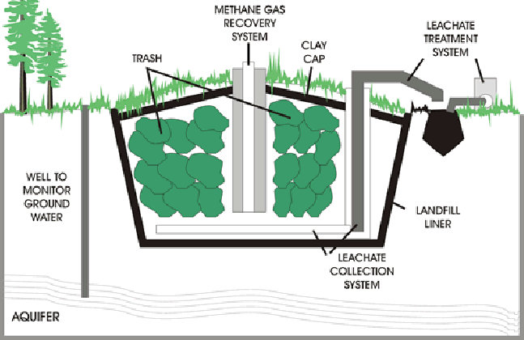
SOLID WASTES SANITARY LANDFILLS
Solid wastes sanitary landfills process is simple, clean and effective. In this procedure, layers are compressed with some mechanical equipment and covered with earth, leveled, and compacted.
A deep trench of 3 to 5 m is excavated and micro-organisms act on the organic matter and degrade them.
Sanitary Landfills are designed to greatly reduce or eliminate the risks that waste disposal may pose to the public health and environmental quality.
MAIN FEATURES OF A MODERN LANDFILL
(SANITARY LANDFILL)

Slide 33
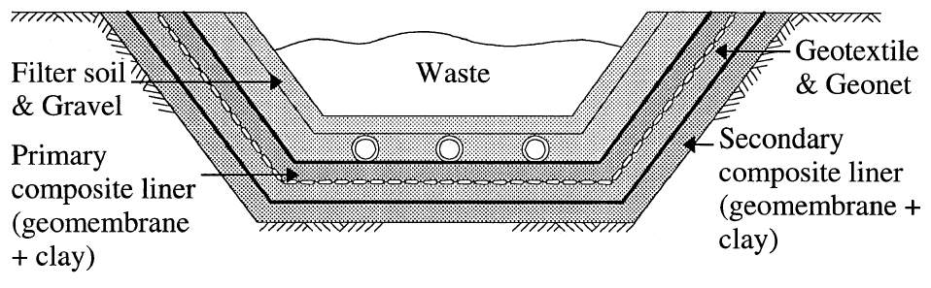
LANDFILL LINER
A landfill liner, or composite liner, is intended to be a low permeable barrier, which is laid down under engineered landfill sites. Until it deteriorates, the liner retards migration of leachate, and its toxic constituents, into underlying aquifers or nearby rivers, causing spoliation of the local water.
MATERIALS USED
Clay
Geomembrane
PVC
HDPE
Geotextiles
Geosynthetic clay liner
Geonets

Slide 34
CLAY
Clay soils are widely accepted as major components of lining systems in waste containment barriers due to its impermeable nature having the value is less than 10⁻⁶ cm/sec.
ADVANTAGES:
Low hydraulic conductivity
High Attenuation of Chemicals
Low Diffusivity
Ductility
Slope stability
Adequate Interface Strength
Long Term Stability
Constructability
DISADVANTAGES:
Desiccation cracking
Freeze-thaw cracking
Thermal stress cracking
Chemical degradation

Slide 35
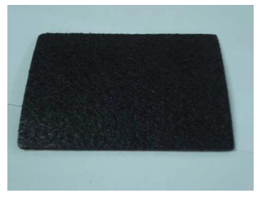
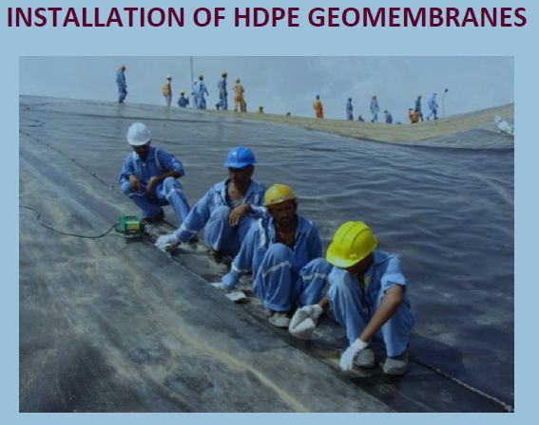
GEOMEMBRANES
Geomembranes are also called flexible membrane liners (FML). These liners are constructed from various plastic materials, including polyvinyl chloride (PVC) and high-density polyethylene (HDPE).
ADVANTAGES OF GEOMEMBRANE:
It is thick impervious sheets having thickness 3mm to 5mm approximately and it contains liquid and gases.
It is a flexible sheet of polymeric material and is virtually impermeable.
Geomembranes are available in the form of rolls of about 6.5 m width and 150m length.
Geomembrane liners are generally provided along with the clay.
The HDPE membranes are hugely in demand because of their environmental friendly and mechanical characteristics.

Slide 36
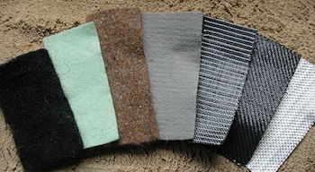
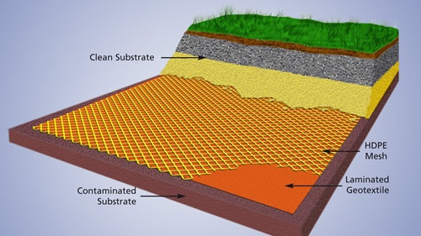
GEOTEXTILES
In landfill liners, geotextiles are used to prevent the movement of small soil and refuse particles into the leachate collection layers and to protect geomembranes from punctures.
These materials allow the movement of water but trap particles to reduce clogging in the leachate collection system.

Slide 37
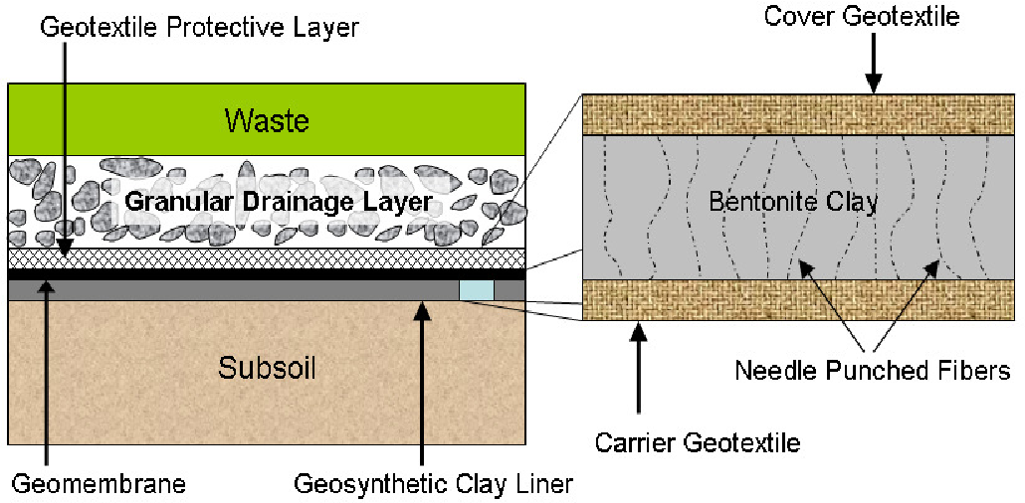
GEOSYNTHETIC CLAY LINER
Geosynthetic clay liners are becoming more common in landfill liner designs. These liners consist of a thin clay layer (four to six millimeters) between two layers of a geotextile.
These liners can be installed more quickly than traditional compacted clay liners, and the efficiency of these liners is impacted less by freeze-thaw cycles.
ADVANTAGES:
Consists of a core of Bentonite clay sandwiched between layers of thick non-woven geotextile.
Applied below and above geomembrane layers in land fills.
It has self repair mechanism
Bentonite expands when fluid leaks through punctured geomembrane – closes the gap.

Slide 38
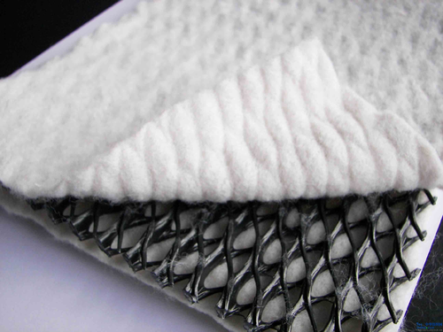
GEONETS
A geonet is a plastic net-like drainage blanket which may be used in landfill liners in place of sand or gravel for the leachate collection layer
Geonets are planar products
Consists of rips in two directions
Apertures are of diamond shape
Rips in the two directions are at different planes.
Water flows along the geonet because of large thickness.
Geonets are also referred to as geospacers.
HDPE DRAINAGE GEONET

Slide 39
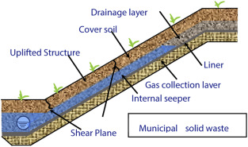
LANDFILL COVER
It used to minimize infiltration of storm water in the landfill body and to allow storm water runoff, a surface sealing system has to be installed after the final completion of each landfill part.
DAILY COVER:
Daily cover is generally applied to the working surface, flanks and working face of an active site to minimize the potential of the site to pollute the environment, harm human health or detrimentally affect the amenity of the locality.

Slide 40
OBJECTIVE
To control the amount of storm water filtration into the waste to reduce leachate quantities
To prevent erosion
To minimise the migration of greenhouse gases (GHG) into the atmosphere
To protect the base sealing (impermeable) layer
To minimise other emissions causing negative impacts on the environment
To prevent odors causing a problem off site
To minimise the risk of fire on or within the site
To ensure the visual appearance of the site is not seriously detrimental to the amenity of the locality

Slide 41
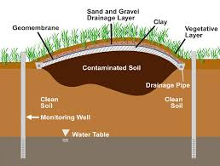
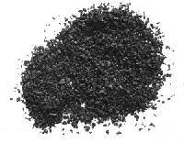
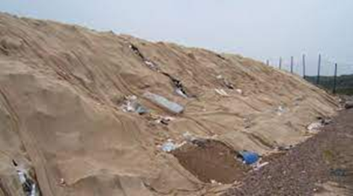
MATERIAL USED FOR COVER
Soils
Quarry waste
Foundry sand
Foams
Geotextile matting
Plastic film
Shredded tyres
Shredded green waste
Synthetic mesh
Hessian sheet
Ash
SOIL AS A COVER
SHREDDED TYRES
HESSIAN SHEET

Slide 42
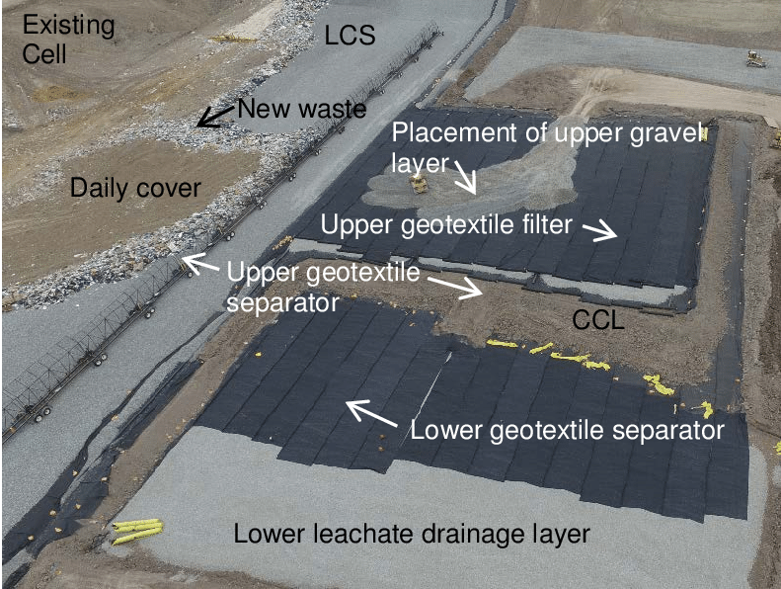
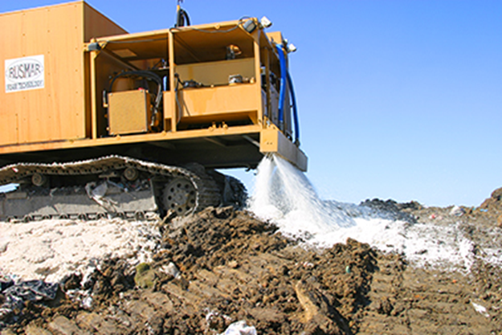
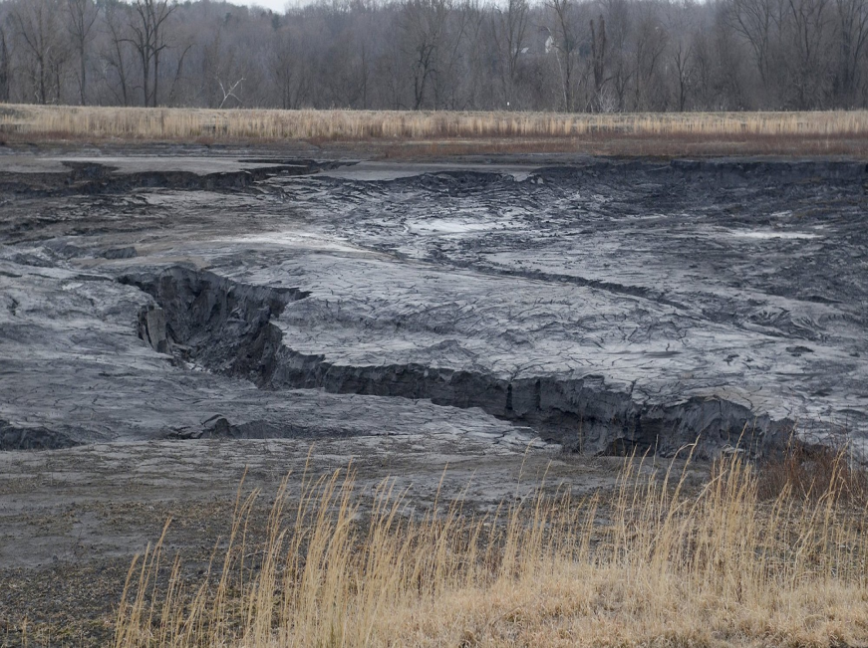
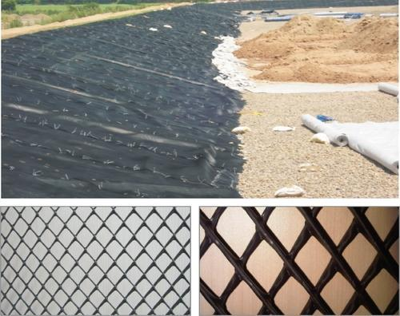
GEOTEXTILE COVER
FOAM SPRAY
COAL ASH
SYNTHETIC MESH

Slide 43
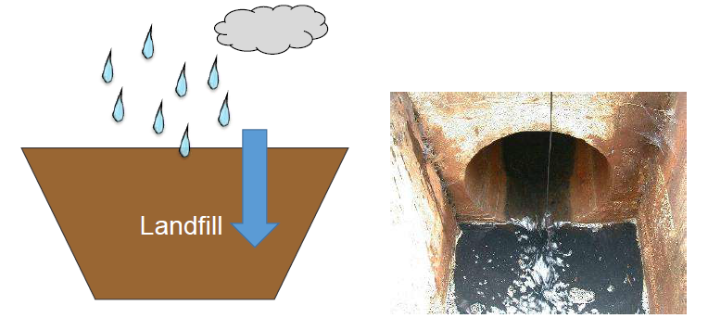
What is leachate?

Slide 44
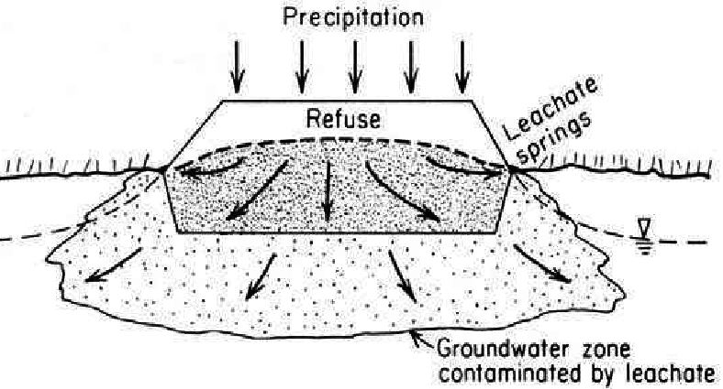
LEACHATE
Leachate - formed when rain water filters through wastes placed in a landfill. When this liquid comes in contact with buried wastes, it leaches, or draws out, chemicals or constituents from those wastes.
It is a mixture of organic degradation products, liquid waste and rain water.
It has high organic carbon content, high concentrations of nitrogen and is usually slightly acidic.

Slide 45
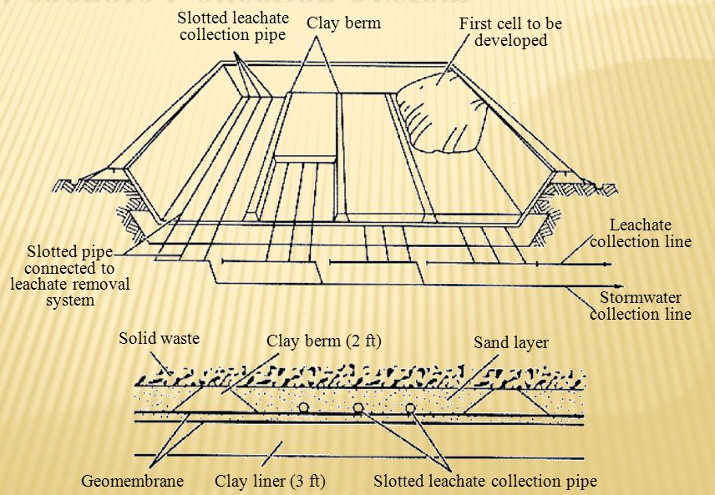
LEACHATE COLLECTION SYSTEM
Leachate may be defined as the liquid that has percolated through solidwaste and has extracted dissolved or suspended materials from it.
The use of clay has favored in reducing the leachate percolation.
A leachate collection system basically consists of a drainage layer of inert material with high permeability, of drainage pipes which have to collect the leachate and to discharge it out of the dumping area.

Slide 46
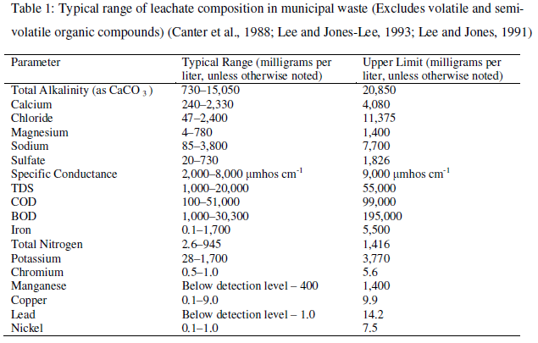

Slide 47
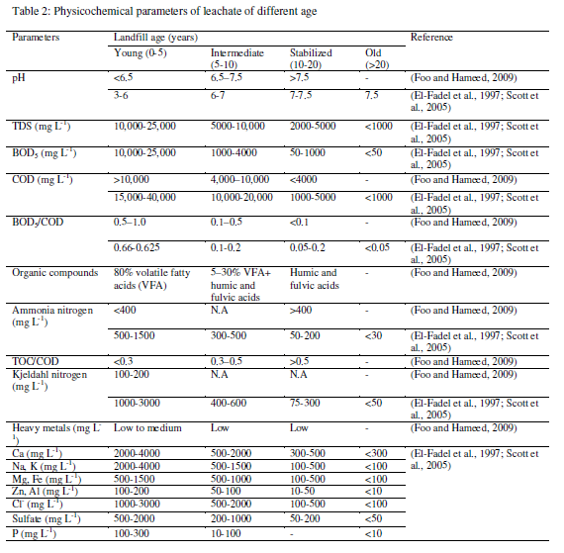

Slide 48
PROBLEMS OF LANDFILL LEACHATE
Leachate can pollute both groundwater and surface water supplies. The degree of pollution will depend on local geology and hydrogeology, nature of waste and the proximity of susceptible receptors. Once groundwater is contaminated, it is very costly to clean it up. Landfills, therefore, undergo siting, design and construction procedures that control leachate migration.
LEACHATE MIGRATION :
It is generally difficult to predict the movement of escaped leachate accurately.
The main controlling factors are the surrounding geology and hydrogeology.
Escape to surface water may be relatively easy to control, but if it escapes to groundwater sources, it can be very difficult both to control and clean up.
The degree of groundwater contamination is affected by physical, chemical and biological actions.
The relative importance of each process may change, however, if the leachate moves from the landfill to the sub-surface region.

Slide 49
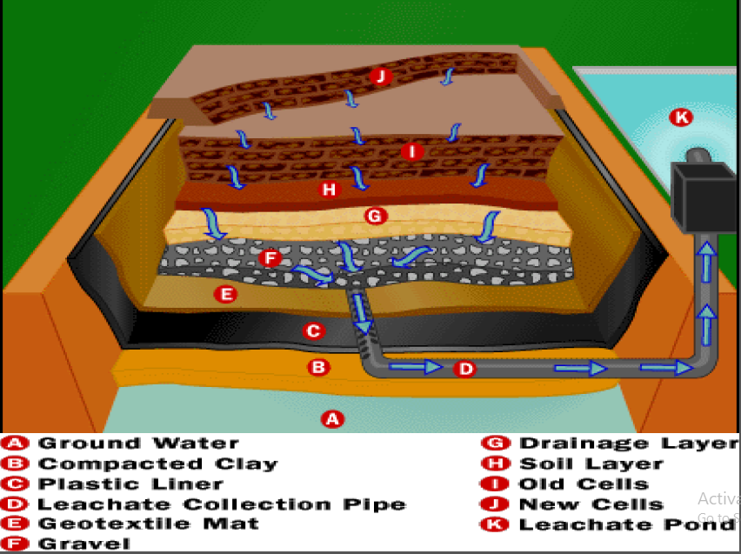
LEACHATE MANAGEMENT
Prevention of leakage
Laying impermeable member
Natural and synthetic liners
Leachate collection
Providing drainage layer and pipes
Reducing the infiltration of water
Top cap and drainage layer
Treatment
Water reduction and purifier

Slide 50
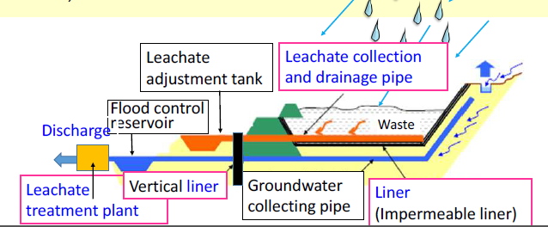
LEACHATE MANAGEMENT

Slide 51
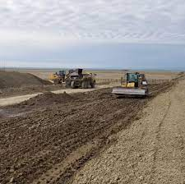
LEACHATE CONTROL SYSTEM
The best way to control leachate is through prevention, which should be integral to the site design.
In most cases, it is necessary to control liquid access, collection and treatment, all of which can be done using the following landfill liners.
NATURAL LINERS:
These refer to compacted clay or shale, bitumen or soil sealants, etc., and are generally less permeable, resistant to chemical attack and have good sorption properties.
They generally do not act as true containment barriers, because sometimes leachate migrates through them.

Slide 52
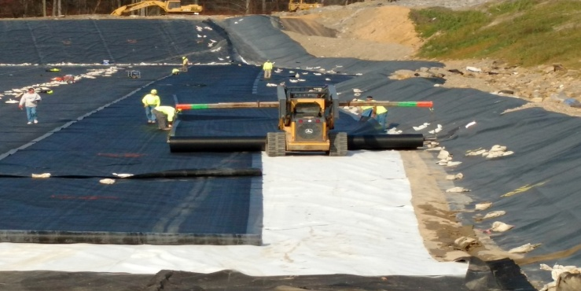
LEACHATE CONTROL SYSTEM
SYNTHETIC (GEO-MEMBRANE) LINERS:
These are typically made up of high or medium density polyethylene and are generally less permeable, easy to install, relatively strong and have good deformation characteristics.
They sometimes expand or shrink according to temperature and age. Note that natural and geo-membrane liners are often combined to enhance the overall efficiency of the containment system.
Some of the leachate collection systems include impermeable liner, granular material, collection piping, leachate storage tank; leachate is trucked to a wastewater treatment facility.

Slide 53
LEACHATE TREATMENT
NATURAL SYSTEM:
Stabilization pond
Wetland construction
Leachate circulation
Aerated lagoons
BIOLOGICAL TREATMENT:
Activated sludge
Up flow anaerobic sludge blanket
PHYSIOCHEMICAL TREATMENT:
Coagulation sedimentation
Filtration
Advanced oxidation process

Slide 54
BIOLOGICAL TREATMENT
Biological treatment is worldwide the most common practice for leachate treatment. Biological systems can be divided in anaerobic and aerobic treatment processes. Both can be realized by using different plant concepts.
This removes BOD, ammonia and suspended solids.
Leachate from land filled waste can be readily degraded by biological means, due to high content of volatile fatty acids (VFAs).

Slide 55
BIOLOGICAL TREATMENT
The common methods are aerated lagoons (i.e., special devices which enhance the aerobic processes of degradation of organic substances over the entire depth of the tank) and activated sludge process, which differs from aerated lagoons in that discharged sludge is recirculated and is often used for BOD and ammonia removal.
While under conditions of low COD, rotating biological contactors (i.e., biomass is brought into contact with circular blades fixed to a common axle which is rotated) are very effective in removing ammonia.
In an anaerobic treatment system, complex organic molecules are fermented in filter. The common types are anaerobic filters, anaerobic lagoon and digesters.

Slide 56
PHYSICOCHEMICAL TREATMENT
After biological degradation, effluents still contain significant concentrations of different substances.
Physicochemical treatment processes could be installed to improve the leachate effluent quality.
Some of these processes are flocculation-precipitation. (Note that addition of chemicals to the water attracts the metal by floc formation).
Separation of the floc from water takes place by sedimentation, adsorption and reverse osmosis.

Slide 57
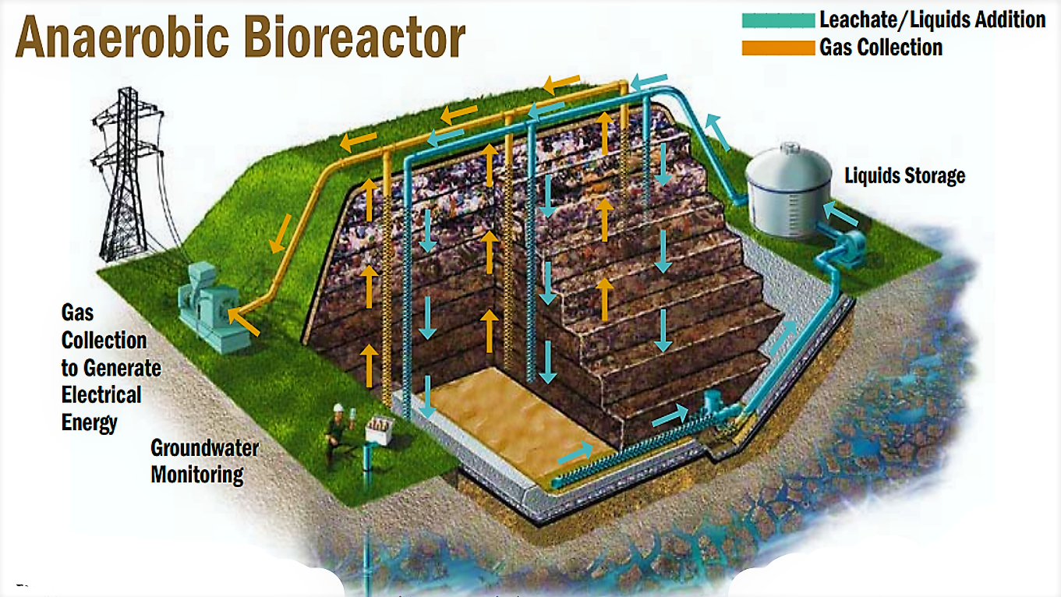
LANDFILL GAS MANAGEMENT
Landfill gas (LFG) is a natural byproduct of the decomposition of organic material in landfills.
LFG is composed of roughly 50 percent methane (the primary component of natural gas), 50 percent carbon dioxide (CO₂) and a small amount of non-methane organic compounds.
Methane is a potent greenhouse gas 28 to 36 times more effective than CO₂ at trapping heat in the atmosphere over a 100-year period,

Slide 58
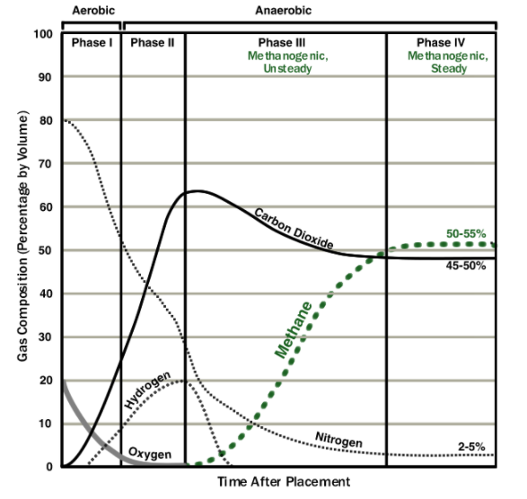
LANDFILL GAS MANAGEMENT
PHASES OF DECOMPOSITION OF WASTE AND GENERATION OF GAS WITH THE TIME

Slide 59
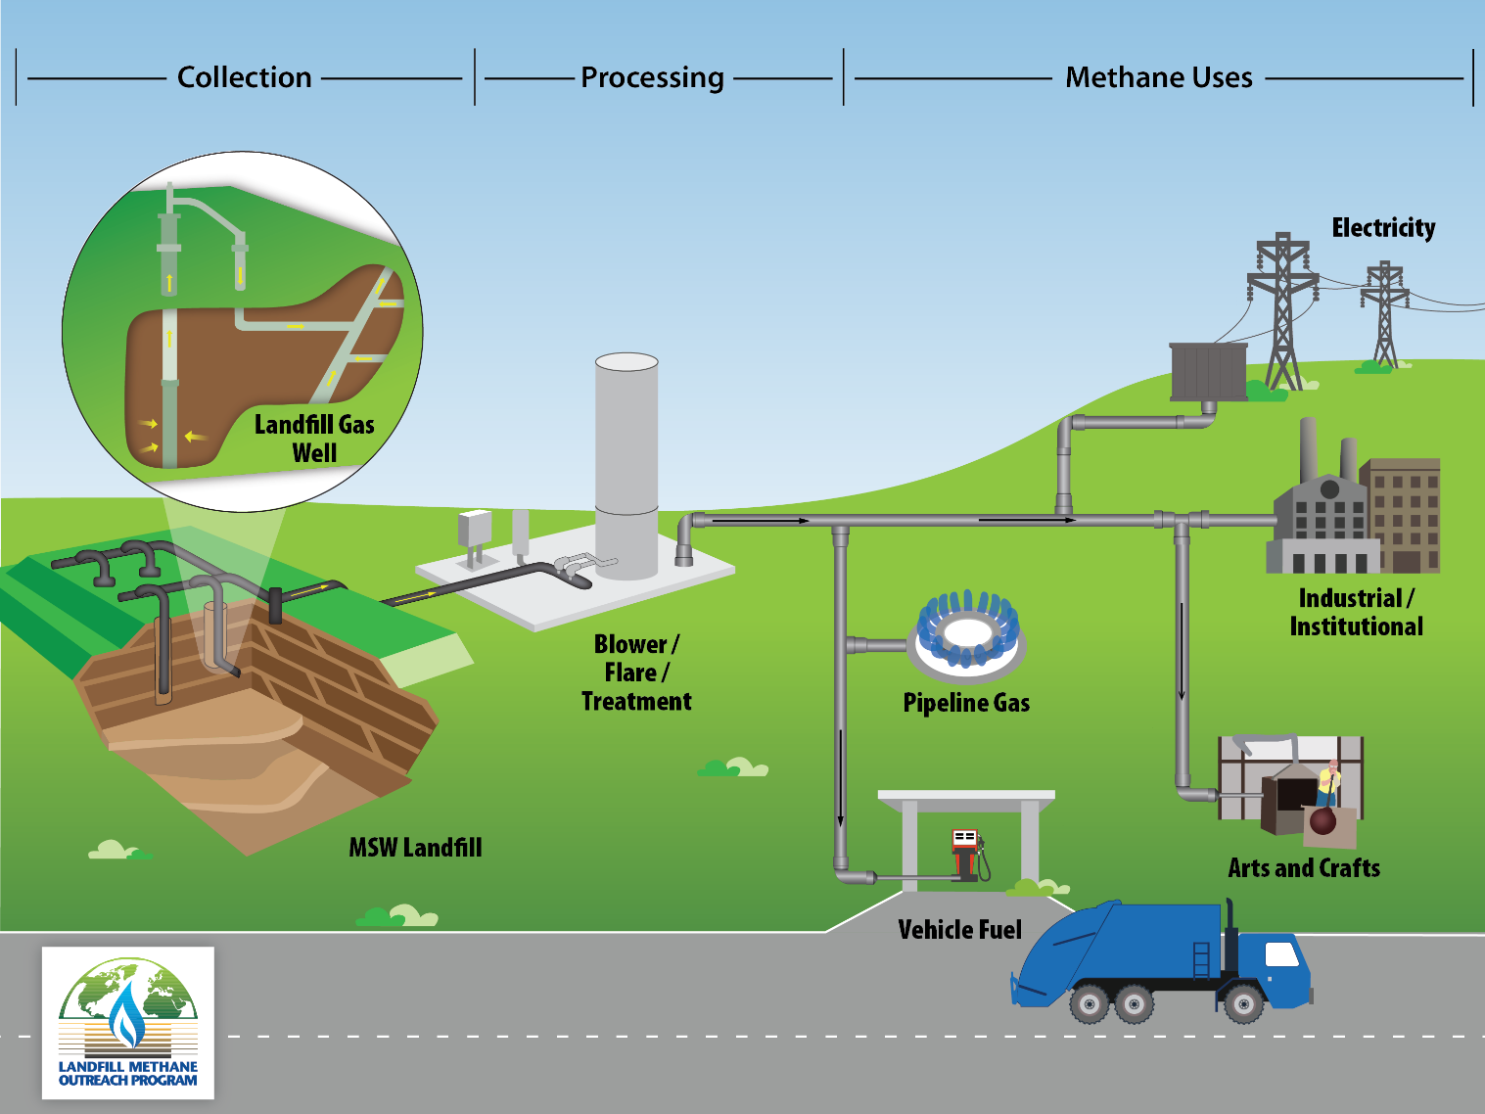
COLLECTING AND TREATING LANDFILL GAS
Instead of escaping into the air, LFG can be captured, converted, and used as a renewable energy resource.
Using LFG helps to reduce odors and other hazards associated with LFG emissions, and prevents methane from migrating into the atmosphere and contributing to local smog and global climate change.
In addition, LFG energy projects generate revenue and create jobs in the community and beyond.

Slide 60
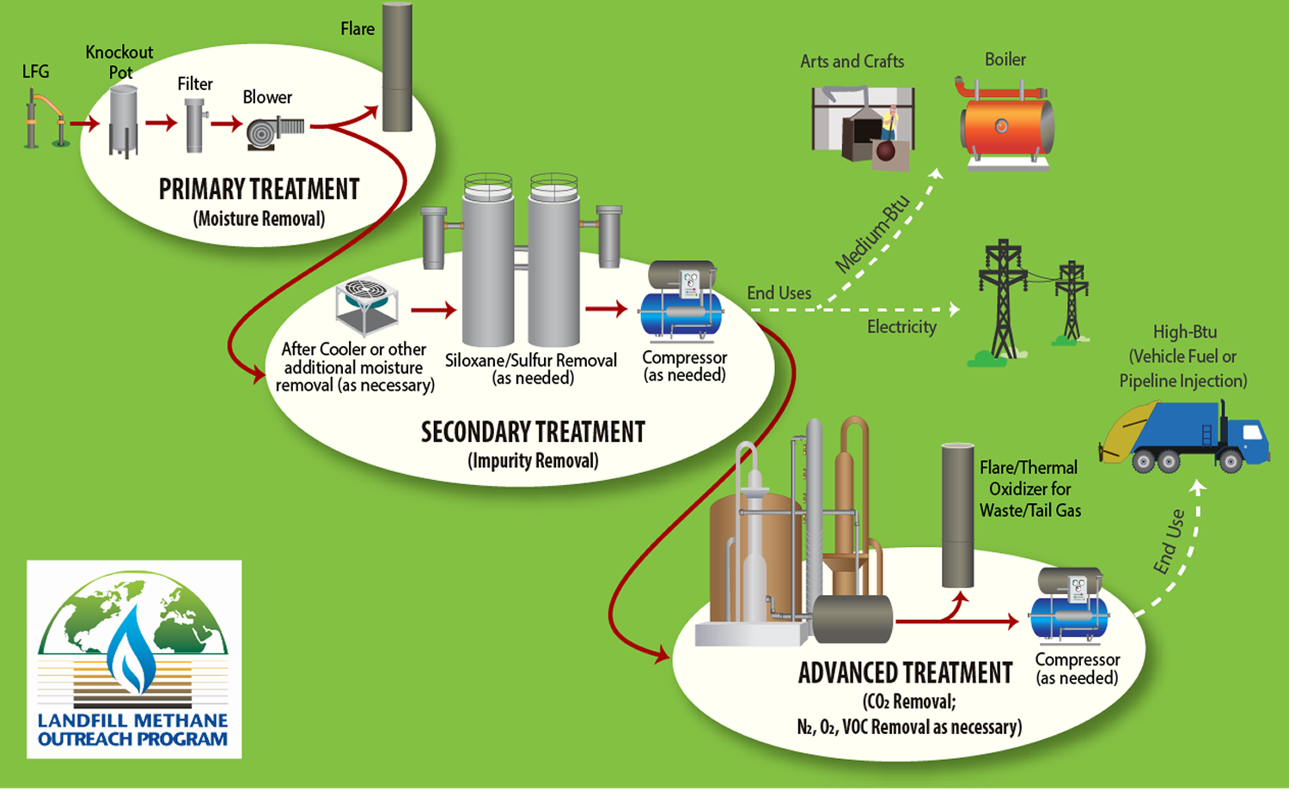
COLLECTING AND TREATING LANDFILL GAS
The graphic illustrates the collection and processing of LFG to produce methane for multiple uses.
First, LFG is collected through vertical and horizontal piping buried in an MSW landfill. The LFG is then processed and treated for use.
The graphic shows potential end uses of LFG including industrial/institutional uses, arts and crafts, pipeline gas, and vehicle fuel.

Slide 61
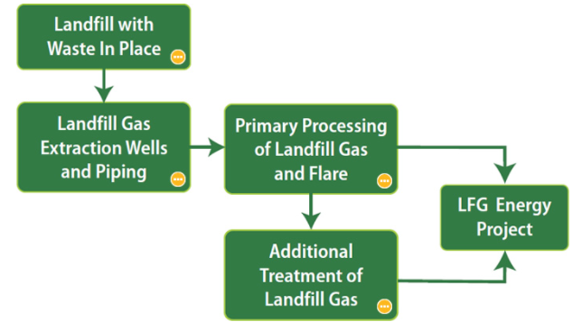
FLOWCHART OF A BASIC LFG COLLECTION AND PROCESSING SYSTEM

Slide 62
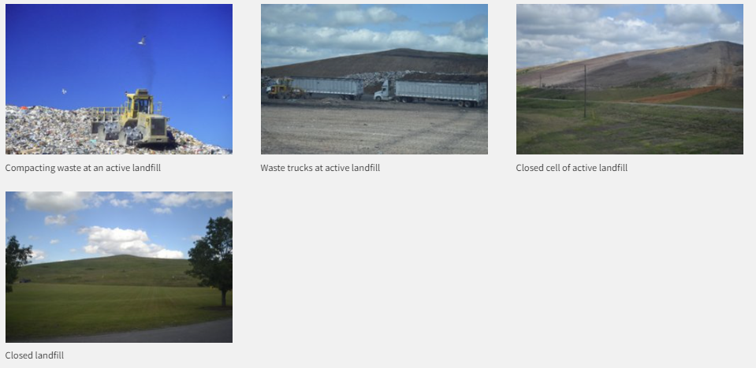
LANDFILL WITH WASTE IN PLACE
A municipal solid waste (MSW) landfill is a discrete area of land or excavation that receives household waste, and may also receive other types of nonhazardous wastes.
Collection of LFG typically begins after a portion of a landfill, known as a “cell”, is closed to waste placement.
COMPACTING WASTE AT
AN ACTIVE LANDFILL
WASTE TRUCK AT
ACTIVE LANDFILL
CLOSED CELL OF ACTIVE LANDFILL
CLOSED LANDFILL

Slide 63
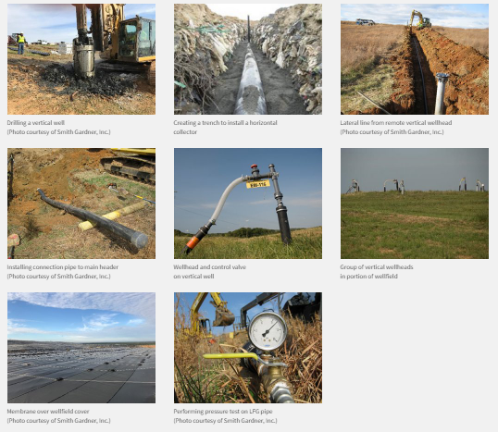
LANDFILL GAS EXTRACTION WELLS AND PIPING
LFG collection systems can be configured as vertical wells or horizontal trenches. The most common method is drilling vertical wells into the waste mass and connecting the wellheads to lateral piping that transports the gas to a collection header using a blower or vacuum induction system.
Horizontal trench systems are useful in areas of active filling. Some landfills use a combination of vertical wells and horizontal collectors. Collection system operators “tune” or adjust the well field to improve collection.

Slide 64
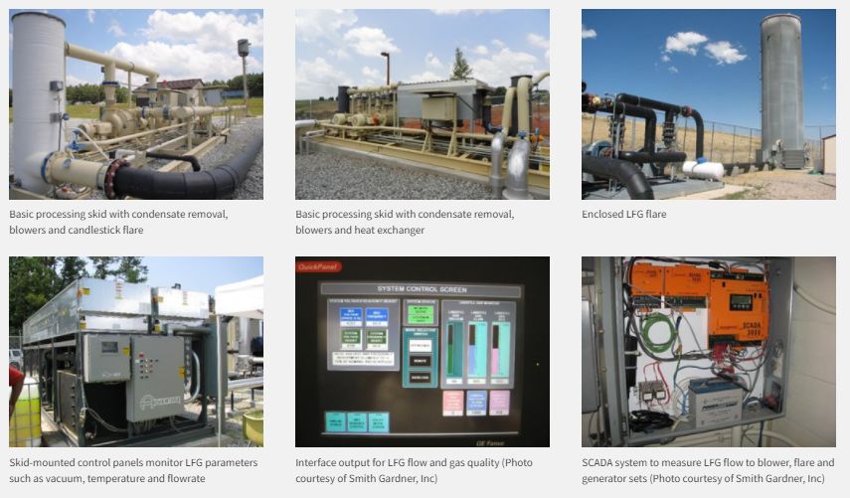
PRIMARY PROCESSING OF LANDFILL GAS AND FLARE
A basic LFG processing skid includes a knock-out drum to remove moisture, blowers to provide a vacuum to “pull” the gas and pressure to convey the gas, and a flare. System operators monitor parameters to maximize system efficiency.

Slide 65
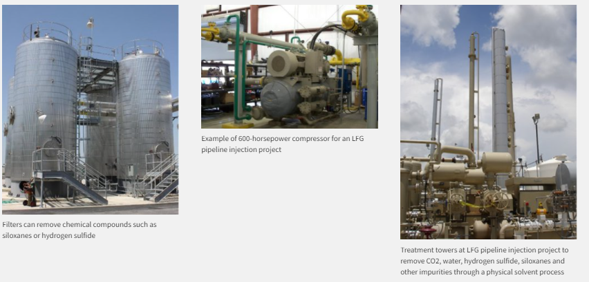
ADDITIONAL TREATMENT OF LANDFILL GAS
Using LFG in an energy recovery system usually requires some treatment of the gas to remove excess moisture, particulates and other impurities. The type and extent of treatment depend on site-specific LFG characteristics and the type of energy recovery system. Some end uses, such as pipeline injection or vehicle fuel projects, require additional cleaning and compression of the LFG.

Slide 66
ENVIRONMENTAL EFFECTS OF LANDFILL
The environmental effects of a landfill include wind-blown litter and dust, noise, obnoxious odor, vermin and insects attracted by the waste, surface runoff and inaesthetic conditions.
Gas and leachate problems also arise during the operation phase and require significant environmental controls. In what follows, we will describe some of the major environmental effects below:
Wind-blown litter and dust are continuous problems of the ongoing landfill operation and a nuisance to the neighborhood.
Covering the waste cells with soil and spraying water on dirt roads and waste in dry periods, in combination with fencing and movable screens, may minimize the problem of wind-blown litter and dust.

Slide 67
ENVIRONMENTAL EFFECTS OF LANDFILL
Movement of waste collection vehicles, emptying of wastes from them, compactors, earthmoving equipment, etc., produce noise.
Improving the technical capability of the equipment, surrounding the fill area with soil embankments and plantations, limiting the working hours and appropriately training the workforce will help minimize noise pollution.
Surface run-off, which has been in contact with the land filled waste, may be a problem in areas of intense rainfall. If not controlled, heavily polluted run-off may enter directly into creeks and streams. Careful design and maintenance of surface drains and ditches, together with a final soil cover on completed landfill sections, can help eliminate this problem.

Slide 68
ENVIRONMENTAL EFFECTS OF LANDFILL
Gas released, as a result of degradation or volatilisation of waste components, causes odour, flammability, health problems and damage of the vegetation (due to oxygen depletion in the root zone). The measures to control this include liners, soil covers, passive venting or active extraction of gas for treatment before discharge into the atmosphere.
Polluted leachate appears shortly after disposal of the waste. This may cause groundwater pollution and pollution of streams through sub-surface migration. Liners, drainage collection, treatment of leachate, and groundwater and downstream water quality monitoring are necessary to control this problem.

Slide 69
ENVIRONMENTAL EFFECTS OF LANDFILL
Birds (e.g., scavengers), vermin, insects and animals are attracted to the landfill for feeding and breeding. Since many of these may act as disease vectors, their presence is a potential health problem.
An operating landfill, where equipment and waste are exposed, appears inaesthetic. This problem may be reduced by careful design of screening soil embankments, plantings, rapid covering and re-vegetation of filled sections.

Slide 70
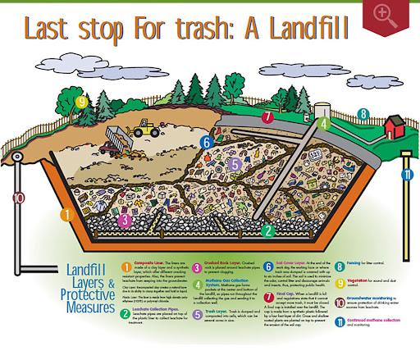

Slide 71
LANDFILL GAS EMISSION
Landfill gas contains a high percentage of methane due to the anaerobic decomposition of organic matter, which can be utilized as a source of energy.
A typical landfill gas contains:
Methane: This is a colourless, odourless and flammable gas with a density lighter than air, typically making up 50 – 60% of the landfill gas.
Carbon dioxide: This is a colourless, odourless and non-inflammable gas that is denser than air, typically accounting for 30 – 40%.
Oxygen: The flammability of methane depends on the percentage of oxygen. It is, therefore, important to control oxygen levels, where gas abstraction is undertaken.
Nitrogen: This is essentially inert and will have little effect, except to modify the explosive range of methane.

Slide 72
HAZARDS OF LANDFILL GASES
Landfill gas consists of a mixture of flammable, asphyxiating and noxious gases and may be hazardous to health and safety, and hence the need for precautions. Some of the major hazards are listed below:
Explosion and fire: Methane is flammable in air within the range of 5 – 15% by volume, while hydrogen is flammable within the range of 4.1 – 7.5% (in the presence of oxygen) and potentially explosive. Fire, occurring within the waste, can be difficult to extinguish and can lead to unpredictable and uncontrolled subsidence as well as production of smoke and toxic fumes.

Slide 73
HAZARDS OF LANDFILL GASES
TRACE COMPONENTS: These comprise mostly alkanes and alkenes, and their oxidation products such as aldehydes, alcohols and esters. Many of them are recognized as toxicants, when present in air at concentrations above occupational exposure standards.
GLOBAL WARMING: Known also as greenhouse effect, it is the warming of the earth’s atmosphere by the accumulation of gases (methane, carbon dioxide and chlorofluorocarbons) that absorbs reflected solar radiation.
MIGRATION: During landfill development, most of the gas produced is vented to the atmosphere, provided the permeable intermediate cover has been used. While biological and chemical processes affect gas composition through methane oxidation, which converts methane to carbon dioxide, physical factors affect gas migration.

Slide 74
CONTROL OF LANDFILL GAS EMISSION
To control gas emission, it is necessary to control the following:
Waste inputs (i.e., restrict the amount of organic waste).
Processes within the waste (i.e., minimize moisture content to limit gas production).
Migration process (i.e., provide physical barriers or vents to remove the gas from the site and reduce gas pressure). Since gas migration cannot be easily prevented, removal is often the preferred option. This is done by using vents (extraction wells) within the waste or stone filled vents, which are often placed around the periphery of the landfill site.

Slide 75

EFFECTIVE LANDFILLING

Slide 76
INTEGRATED WASTE MANAGEMENT (IWM)
Basic idea of ISWM is to segregate wet and dry waste at source.
Have separators in transport vehicles and track where the waste is being disposed off through GPS in vehicles.
Analyze suitable site locations for landfill.
By following segregation and tracking any city can be made clean and hygiene.
Garbage bins can be removed through this process.
Health and safety have been, and still remain, the major concerns in waste management, and, therefore, waste must be managed in such a way as to minimize risks to human health.
Today, the society demands a waste management system that is not only safe but also environmentally and economically sustainable.
Note that sustainability refers to development that addresses the needs of the present generation without jeopardizing the ability of future generations to meet their own needs.

Slide 77
PUBLIC EDUCATION AND INVOLVEMENT
Developing integrated solutions for waste management problems requires public involvement.
To operate a waste management programme economically and efficiently, significant cooperation is expected from waste generators, regardless of the strategies chosen – buying products in bulk, separating recyclables from non-recyclables, dropping off garden trimmings at a compost site, removing batteries from materials sent to a waste-to-energy facility, or using designated containers for collecting materials.
To sustain a long-term programme support, the public needs to know clearly the purpose and necessity of desired behaviours.

Slide 78
PUBLIC EDUCATION AND INVOLVEMENT
Involving people in the waste management requires a significant educational effort by the community.
Ineffective or half-hearted education programmes may confuse the public, reduce public confidence or elicit hostility towards the programme.
Successful education programmes must be consistent and ongoing.
Public education stimulates interest in how waste management decisions are made, and when citizens become interested in their community's waste management programmes, they frequently demand to be involved in the decision-making process.
Communities should anticipate such interest and develop procedures for involving the public.

Slide 79
WASTE DISPOSAL: CASE STUDY – BANGALORE
About two-thirds of the waste (about 1600 tonnes/day) in the Bangalore city is getting dumped in the outskirts of the city. As there are no sanitary landfills in the city for proper dumping of waste, it is merely transported to the outskirts and disposed of in any abandoned open land, usually along public highways.
The Bangalore Mahanagara Palike (BMP) along with the Karnataka State Pollution Control Board (KSPCB) has, however, identified 9 abandoned quarries around the city for sanitary landfills.

Slide 80
SOLID WASTE DISPOSAL SITES IDENTIFIED BY THE DEPARTMENT OF SWM, BANGALORE MAHANAGARA PALIKE, BANGALORE, 1998
Sl No. | Name of site | Area (acres)
1 | B. Narayanpura | 10.15
2 | Vibuthipura | 8.01
3 | Devanachikkanahalli | 6.09
4 | Sarakki | 2
5 | Hongasandra | 4.02
6 | Lakkasandra | 10.04
7 | Hennur | 10
8 | Kudittally | 0.36
9 | Adugodi | 2
10 | Mavalipura | 35

Slide 81
SOLID WASTE DISPOSAL SITES IDENTIFIED BY THE DEPARTMENT OF SWM, BANGALORE MAHANAGARA PALIKE, BANGALORE, 1998
Of the sites listed in Table, only 3 have been selected after an assessment of suitability, viz. B. Narayanpura (situated about 10 km northeast of the city in Krishnarajapura hobli), Hennur (situated at a distance of about 9 km north of the city) and Devanachikkanahalli (situated about 10 km to the southeast of the city).
These sites were selected on the basis of the geo-technical assessment carried out after a site visit and review of data.
However, a periodical assessment of ground water and air quality, before and during the process of land filling, is necessary.

Slide 82
https://www.youtube.com/watch?v=UAscjVNNF0Q
https://www.youtube.com/watch?v=RylxA1b54Bw

